Slide 1

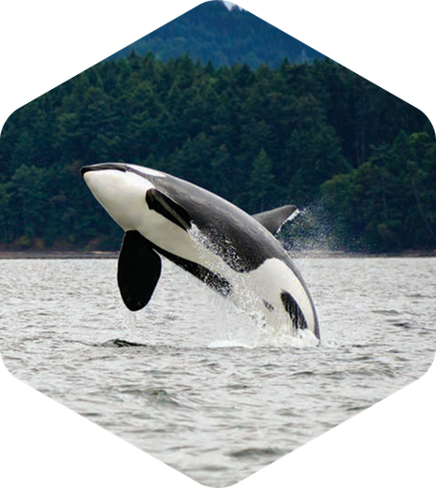


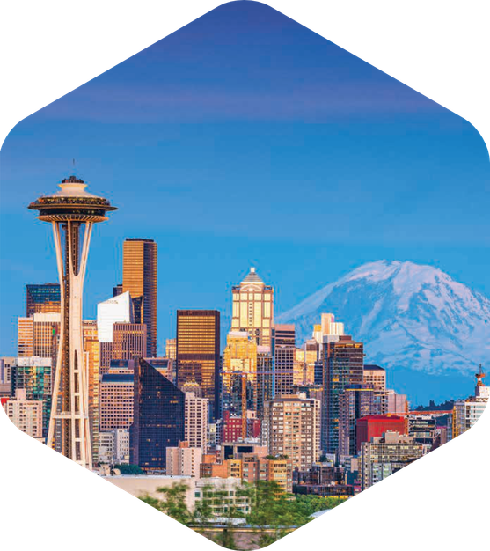


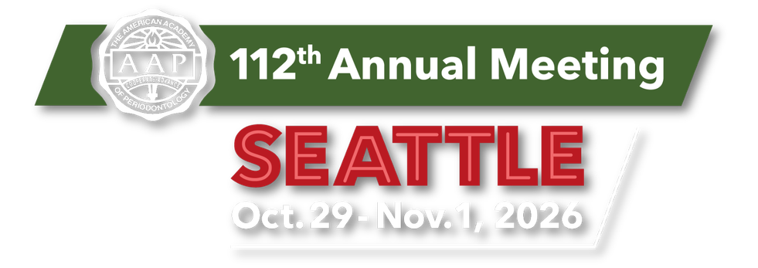


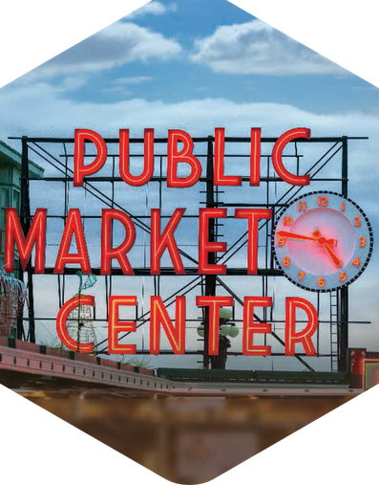
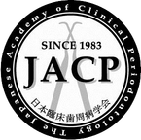

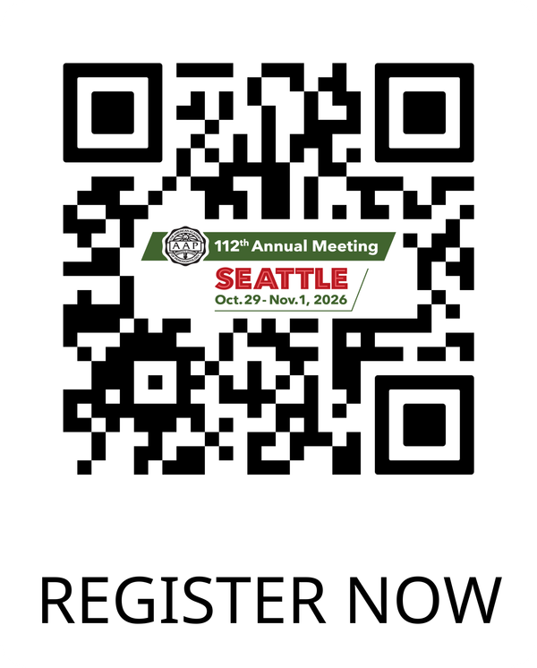
Held in collaboration with
the Japanese Academy of Clinical Periodontology and the Japanese Society of Periodontology
Visit the Emerald City of the Northwest and experience:
An Opening General Session featuring AAP members and the cases that shaped their careers
Highlights from the 2026 Best Evidence Consensus
Balint Orban, Research Forum, and the premiere of the Saving Teeth Competition
Bonus educational opportunities including the Corporate Forum, Lunch and Learns, Speaker Studio, and Global Speaker Pavilion

